Slide 1


Vishwakarma Institute of Technology
GSM Based Fire and Smoke Detection and Prevention System
Guide -:Prof. Jitendra Gaikwad
Shaunak Deshpande (39)
Aditya Rotithor (27)
Shrawani Shinde (46)
Adarsh Sapkal (32)

Slide 2
CONTENTS
01.Introduction
02.Problem Statement
03.Objectives
04.Literature Survey
05.System Components
06.Software Requirements
07.Flowchart
09.Architecture Diagram
12.Conclusion
13.References

Slide 3
INTRODUCTION
Fire have been known as the dangerous tragedy that could cause destruction, property and life losses.To cope with this there is need of system that can send danger alerts early enough so that preventive steps can be taken.

Slide 4

PROBLEM STATEMENT
To design a system to detect fire and smoke to triggered alert signal in emergency using Arduino uno.

Slide 5

OBJECTIVES
To design a system that indicates the area in which fire erupted and sounds the alarm if fire occurs.
To Send an SMS alert to the user and nearest fire station.

Slide 6
LITERATURE SURVEY
Sr.No | Paper Name | Author | Year of publication | Techniques
1 | Quick Fire Sensing Model and Extinguishing by Using an Arduino Based Fire Protection Device | 1)Md. Habib, 2)Naureen Khan, 3)Mahbubur Rahman Kiran, | 2019,International Conference on Advances in Electrical Engineering (ICAEE), | Arduino, GSM, GPS
2 | Fire Detection Based on Color, Shape and Motion | 1)Monika Waghmare, 2)Prof. Meenakshi Annamalai | July 2017, International Research Journal of Engineering and Technology (IRJET) | computer vision based fire detection algorithm

Slide 7
LITRETURE SURVEY
Sr.No | Paper Name | Author | Year of publication | Techniques
3 | Smart Fire Warning System | Moosa Al-Ismaili, Mansoor Ali | January-2016,International Journal of Engineering Research & Technology (IJERT) | Microcontroller, Smoke sensor, GPS, GSM.
4 | GPS-based fire detection system (Global Positioning System) and SMS Gateway | A Aryanti, I Mekongga , R S Dewi | 2019 International Conference on Innovation in Science and Technology (ICIST) | ATmega328, DHT11 temperature sensor,

Slide 8
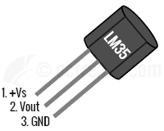
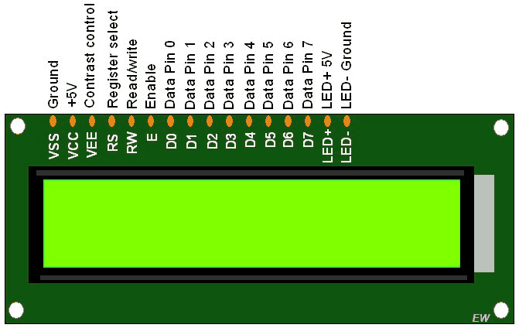
SYSTEM COMPONENTS
1.Temp Sensor LM35
LM35 is prescision Integrated circuit tempreture sensor, whose output voltage varries based on tempreture around it
2.LM016L Display
LCD screen is display module that uses liquid crystal to produce a visible image.

Slide 9

SYSTEM COMPONENTS
3. MQ-2 Smoke Sensor
MQ2 sensor can detect LPG, i-butane, methane, alcohol, Hydrogen and smoke.
4 .SIM 900D GSM Module
The SIM900 is a complete Quad-band GSM/GPRS solution in a SMT module which can be embedded in the customer applications.

Slide 10
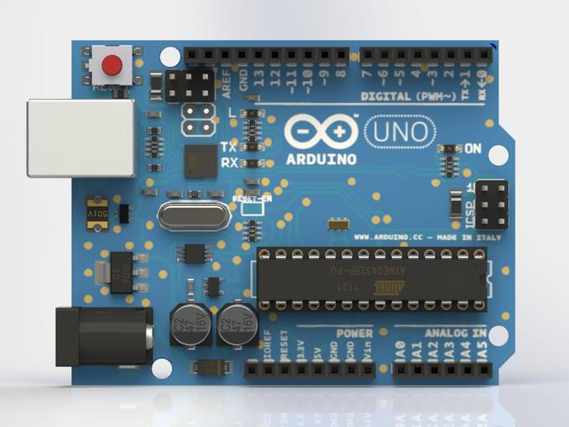
SYSTEM COMPONENTS
5.Arduino UNO R3
Arduino Uno R3 is a microcontroller board based on a removable, dual-inline-package (DIP) ATmega328 AVR microcontroller. It has 20 digital input/output pins

Slide 11


SOFTWARE REQUIREMENTS
Languages used: Embedded C
Simulator used: Proteus 8.11.
IDE used: Arduino 1.8.13
Operating System: Windows 7 or more..

Slide 12
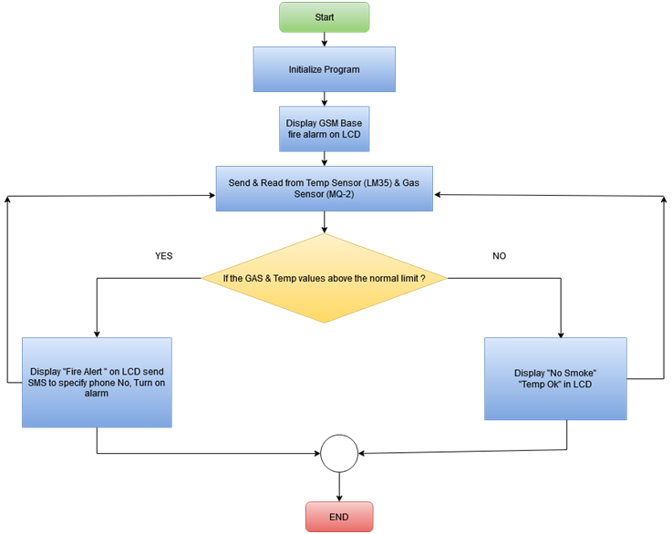
FLOWCHART

Slide 13
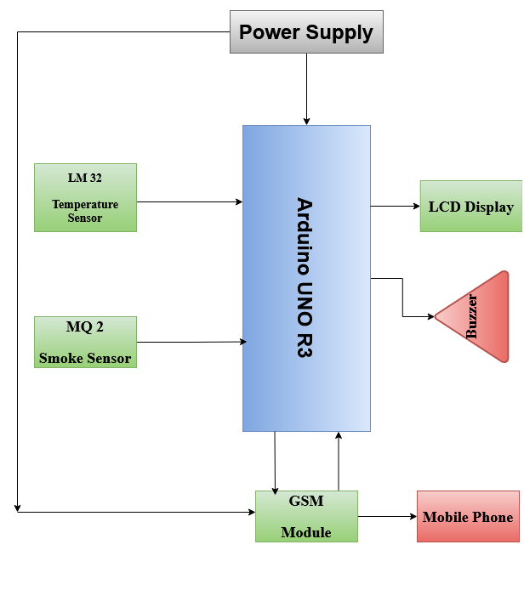
ARCHITECTURE DIAGRAM

Slide 14
CONCLUSION
This system is simple but it has wide area of application in household and industrial safety.
This system can provide a secure,safe, and efficient way for preventing or combating fire accident.

Slide 15
REFERENCES
[1] Moosa Al-Ismaili, Mansoor Ali, ‘Smart Fire Warning System’,2019,International Conference on Advances in Electrical Engineering (ICAEE),
[2] A Aryanti, I Mekongga , R S Dewi,’GPS-based fire detection system (Global Positioning System) and SMS Gateway’, 2019 ,International Conference on Innovation in Science and Technology (ICIST)

Slide 16


